Slide 1
Group 21
BT4016 Presentation
Dylan See Keane Loong
Justin Julius Chu Qijie
Mohamad Nurhakiem Bin Mohamad Rasid
Oon Kei Zee Casey
Notes:
Good Afternoon Prof Huang. We are group 21. My name is Justin and today i will be sharing our final presentation.

Slide 2
Contents
Best and Worst Mutual Funds
Why we choose these two funds
How we optimized our best portfolio weights
Risk and return Performance of 4 portfolios in 2021
Effects of our optimization on the risk return performance in 2021
Our two stocks for hedging and the outcome of hedging results
Notes:
This is the contents of what we will be covering.

Slide 3

1.1Best Mutual Fund - FELAX
- FELAX’s portfolio is heavily focused on semiconductors, holds more than 80% of its assets in this industry.
- Industry: Despite the chip shortage, the semiconductor industry has managed to grow, thus even bigger growth expected in 2021.
- Greater demand for semiconductors for new high-tech products, especially during the pandemic.
Notes:
The best mutual fund we chose is FELAX, Fidelity advisor semiconductors fund. This fund is heavily focused on semiconductors, holding more than 80% of its portfolio in this industry. The semiconductor industry has managed to grow to $464 billion, up 10.8% since 2019 despite a shortage of chips, and thus we expect this industry to grow even further in 2021.
The growing demand for 5G mobile phones, gaming consoles, and other devices; especially during the pandemic will fuel the demand for semiconductors and related hardware components from firms in this fund.

Slide 4

1.2 Worst Mutual Fund - BFOCX
- Individual Stocks: TSLA being overvalued, due to being overly reliant on selling emissions credits.
- Industry: Communications. Due to the possible reopenings of air travel for various countries in 2021, there is lesser need for home communications services in 2021.
Notes:
We chose our worst mutual fund to be BFOCX, the Berkshire Focus Fund, due to several reasons.
One reason is that Tesla is heavily weighted in this fund at 6.07%. We believe that Tsla might see a correction in 2021 due to tesla generating a significant portion of its profits from selling emissions credits. Furthermore, it’s forward P/E ratio is more than 10 times its closest competitors, with far fewer cars sold/year.
Also, there is a poor forecast for the communications sector in 2021, which has a 13.21% weightage. This is due to expected easing of lockdown restrictions in 2021, which will reduce the need for home communications services.

Slide 5
2. Optimization of our portfolio weights for our Best Mutual Fund (FELAX)
2.1 Return Estimation
2.2 Semi-variance Optimization
2.3 Weight and Sector Constraints
2.4 L2 Regularization and comparing weights of Best fund and optimized portfolios
Notes:
Now we will discuss the methods used to optimize our best portfolio weights from our best mutual fund.

Slide 6
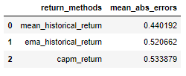
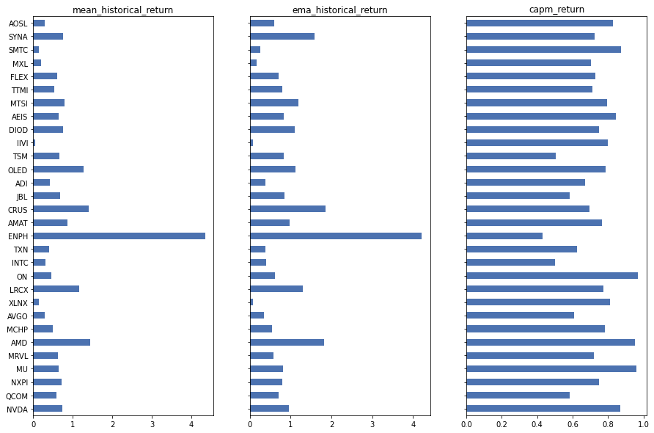
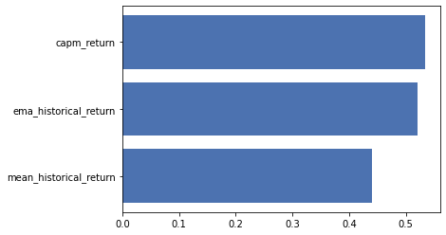
2.1 Return Estimation
Notes:
For mean historical returns, equal weights are applied to all returns across the period, this may not be able to accurately account for the diminishing predictability of older data, we want to determine if other return estimation methods could return better performance.
We plot the mean absolute errors for 3 different return methods: CAPM returns, EMA historical return and Mean historical return on the left hand side. We observe that the capm_returns have a higher mean absolute deviation the other two methods, indicating higher gains but also potentially higher losses.
On the right side, we can observe that CAPM returns are more stable across individual stocks for our portfolio.
As such we decide to use CAPM return estimation.

Slide 7
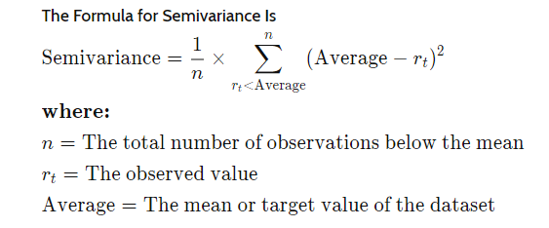
2.2 Semi-variance Optimization
Notes:
Now we optimize our mutual fund holding using the semi-covariance objective function. Semivariance is a measurement used to estimate potential downside risk of a portfolio since it only considers observations that are below the mean or target returns. Since our fund is an aggressive semiconductor growth fund, we are risk-seeking and want to achieve a target annual returns of 80%. We minimise the portfolio semi-variance with target annual returns of 80%.

Slide 8
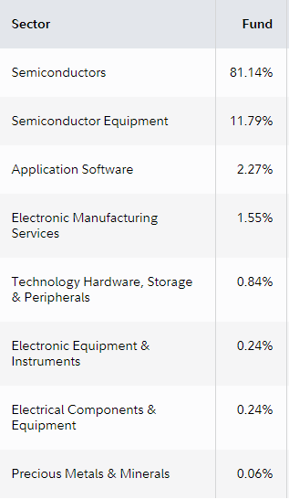
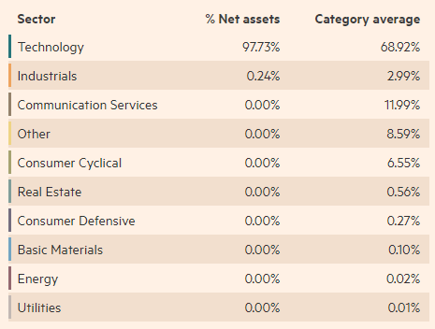
2.3 Weight and Sector Constraints
Notes:
To avoid being too heavily invested in any one particular stock, we set a maximum weight of up to 25%.
For sector constraints, as you can see in the left graphic, FELAX is already heavily engaged in securities of firms engaged in electronics components. Even at the Sub-Industry level as seen on the right graphic, we can see heavy weighting into the semiconductor sub-industry. As such we do not set any sector constraints.

Slide 9
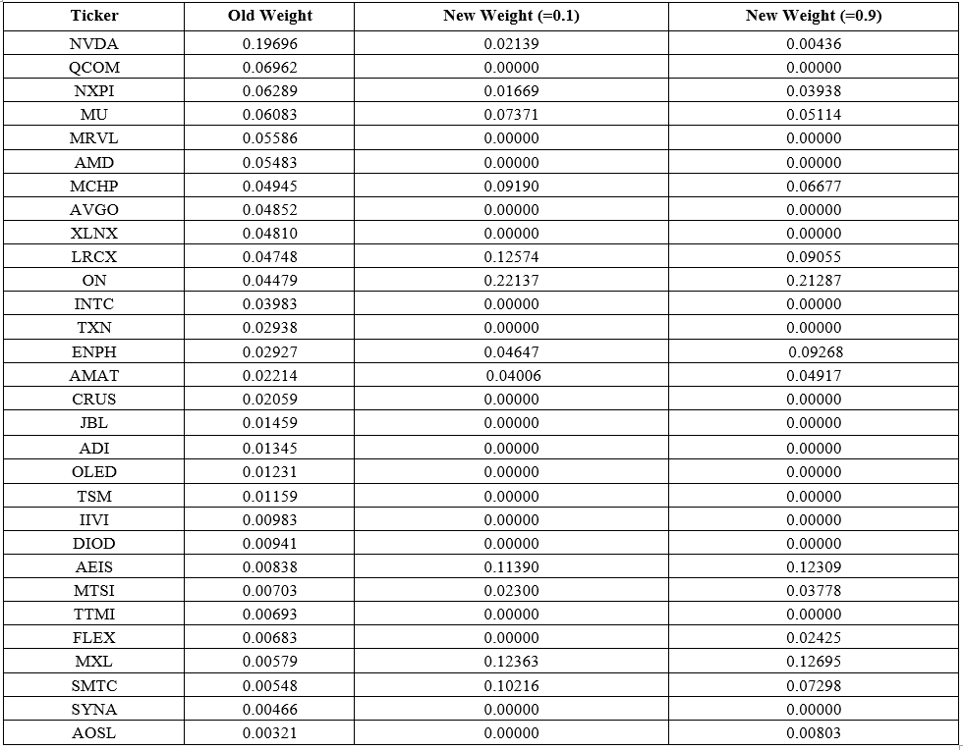
2.4
L2 Regularization and comparing weights of Best fund and Optimized Portfolios
Notes:
When we conducted our efficient frontier optimization, we initially observed far too many securities had weights set to 0. This was not optimal as it left us overexposed to certain firms. To further diversify our risk, we implemented L2 regularization at gamma levels of 0.1 and 0.9 to reduce overfitting towards certain firms and promote smaller weights.
We can observe the initial weights in the first column before conducting our efficient frontier optimization, and two sets of weights for our optimized portfolio with different regularization parameters.

Slide 10

Sharpe Ratio of our Optimized Portfolio
Notes:
We observed that the between the two optimized portfolios, the portfolio of 0.1 gamma was able to marginally reduce our annual volatility without reducing our expected annual return; It also had a higher Sharpe ratio

Slide 11
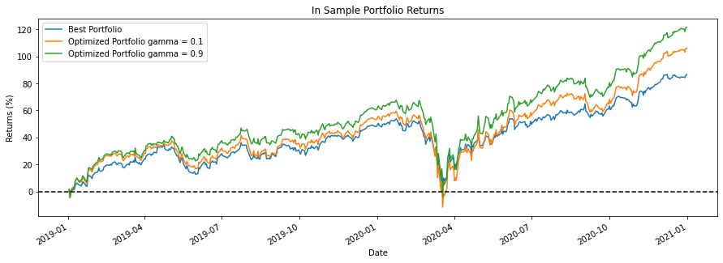
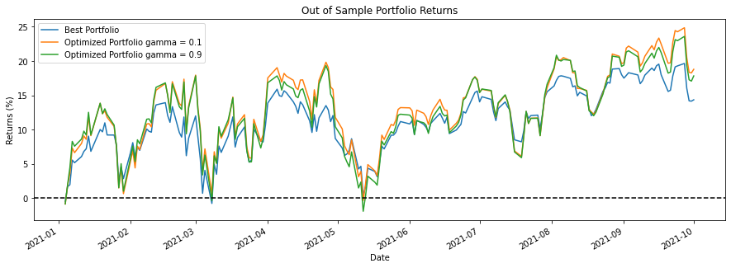
Evaluating Performance of our Optimal Portfolios
Notes:
From the plot of in-sample returns, our gamma of 0.9 portfolio outperforms our gamma of 0.1 portfolio. However, if we observe the plot of out of sample returns, our gamma of 0.1 outperforms our gamma of 0.9 portfolio. This is consistent with our understanding that using a gamma value too high would over penalize large weights and would lead to underfitting and lead to high bias.
Since both optimized portfolios outperform the benchmark we can conclude that some regularization is necessary as too many 0 weights leads to overfitting and will not be able to generalize to new data; however we can also conclude that we should not use a gamma value too high as it may lead to underfitting our data and will not allow our model to make useful predictions. Therefore we conclude the weights with gamma = 0.1 to be optimal portfolio.

Slide 12
4. Risk and Return of Portfolios
Portfolio | YTD Return | Standard Deviation | Oct 2021 Return
Best fund (FELAX) | 93772739 | 23296553 | 31781319
Worst fund (BFOCX) | 33904436 | 17206881 | 38111112
Optimal portfolio (FELAX) | 144661057 | 27592050 | 68370087
Optimal + Adjustments (FELAX) | 224194511 | 49089542 | 94941764
Notes:
The YTD returns and standard deviation of our portfolios are as shown here. We are able to observe that the YTD returns in dollar value for the optimal portfolios perform vastly better than that of our best and worst funds. In addition, FELAX performed much better than BFOCX as we expected.
We also observe a huge increase in standard deviation when comparing our optimal portfolio to our best and worst funds.

Slide 13
5. Comparison of Risk and Return of Portfolios
Sharpe ratio of FELAX in 2021: 3.329
Sharpe ratio of Optimal portfolio (Adjusted) in 2021: 4.3107
Sharpe ratio improved by: 0.9817
Notes:
In order to further analyse the risk and return of our portfolios, we calculated the Sharpe Ratio of our best fund and optimal portfolio. We found that even though our optimal portfolio has had much greater returns than our best fund, it also had much greater risk.
We found that upon tweaking the weights for our optimal portfolio by increasing NVDA weighting, the sharpe ratio of the portfolio increased by 0.7154, representing a better return to risk ratio here.

Slide 14

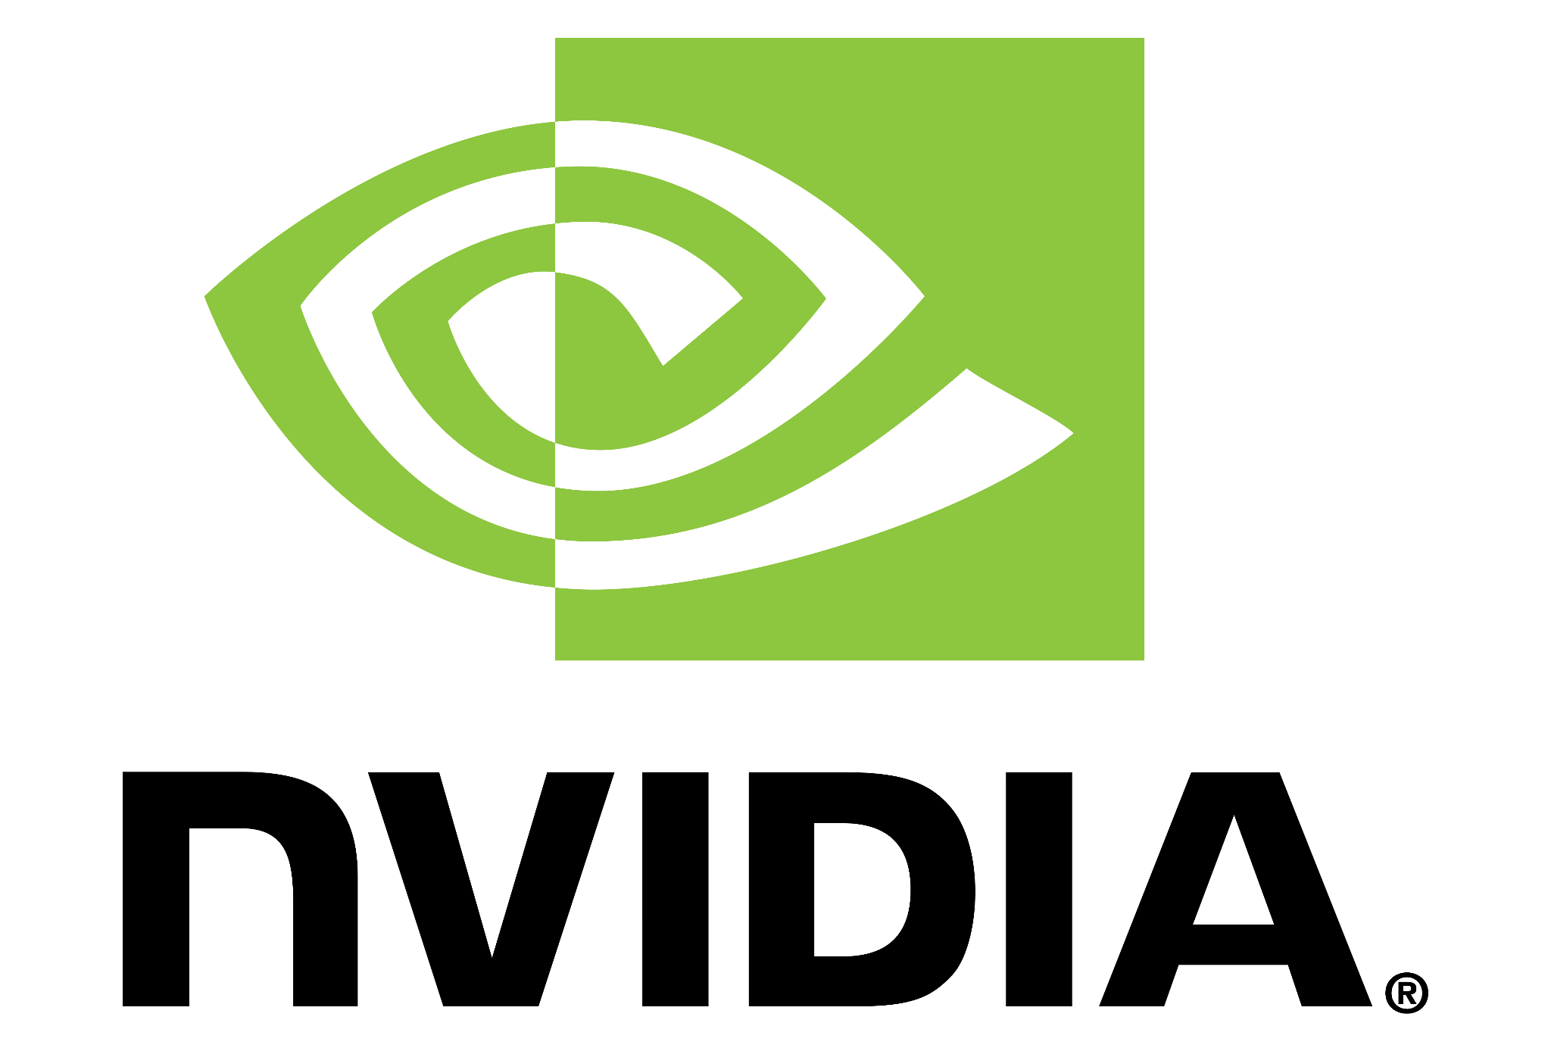
6. Hedging By Options
Stock with Highest Downside Risk: QCOM
Most Uncertain Stock: NVDA
Notes:
We have identified 2 stocks in our best portfolio with high potential risk in the upcoming weeks. Based on historical performance and market sentiment, we have identified QCOM as the stock in our portfolio with the highest downside risk and NVDA as the most uncertain stock. In order to hedge against the risk from these stocks, we utilised certain options strategies based on the findings from our analysis.

Slide 15
Stock with the Highest Downside Risk: QCOM
Poor Historical Performance
QCOM reached a 52-week high in early-2021, has been dropping since
17% drop in price from Sep - Oct, following unsatisfactory news
Stagnation of earnings per share at $1.90 in Q3 from $2.17 in Q1 2021
Industry Factors
63% of Qualcomm’s revenue relies on the mature handset market with low growth
Slower than expected growth in the handset industry
Longer than expected time to diversify into non-mobile industries
Notes:
We believe that QCOM has the highest downside risk due to its historical performance, and future uncertainty. The price of QCOM reached a 52-week high in early-2021 and has been dropping ever since. September being a notably tough month, following a 17% price drop.
Qualcomm’s key risks are slower than expected growth in the handset industry and a longer than expected time to diversify into non mobile-industries. Thus we expect high volatility and downside risk as we approach the Q4 earnings report on 3 Nov.

Slide 16
Stock with the Highest Downside Risk: QCOM
Options Strategy: Protective Puts
Bought one call option for each share of QCOM in portfolio at 18 Oct 2021 that expire on 5 Nov 2021
Exercise Price: $117
Cost: $0.54
Number of Shares of QCOM in Portfolio | 210726
QCOM Adjusted Close (on 18/10/21) | $130.12
-1 Standard Deviation of Return from the Current Stock Price (Puts) | $117.37
 | Exercise Price | Cost
Puts | $117 | $0.54
Notes:
We have decided to buy protective puts to hedge against the possible downside risk of holding QCOM in our portfolio.
We used the implied volatility of ATM puts on 18 Oct to estimate the volatility of the price QCOM till expiration of these options. From there, we chose to purchase put options with exercise price of $117, at once standard deviation below the current stock price. In total, the cost of this options strategy is $113,792.04.

Slide 17
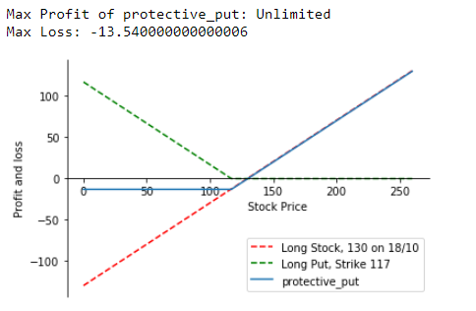
Stock with the Highest Downside Risk: QCOM
Notes:
If the price of QCOM falls significantly up till options expiry, protective puts will allow us to cap our losses from our holdings of QCOM at $13.50 per share while keeping the unlimited upside potential of an increase in price of QCOM.

Slide 18
Stock with the Highest Downside Risk: QCOM
Results, as of Options Expiry at Nov 5
25.29% increase in stock price
Earnings per share increased from $1.92 to $2.55
Date | QCOM Adj Close | % Change
18/10/2021 | $130.12 | -
5/11/2021 | $163.03 | 25.29%
Protective Puts | Profit
Without | 6,934,443.82
With | 6,820,641.77 (1.6% decrease)
Notes:
However, from 18 Oct to 5 Nov, QCOM stock price surged 25.29%. Investors continued to rally after Qualcomm’s strong Q4 earnings report and its success in handling the chip supply shortage.
The protective puts expired Out of the money resulting in a loss in profit of 1.6% from the cost of the put options premium.

Slide 19
Most Uncertain Stock: NVDA
Potential Sharp Uptrend
Strong Historical Performance
Revenue up 68% YTD reported in Aug
Gaming revenue up 85%
Data center revenue up 35%
Earnings per share up 24% from previous quarter
Industry Factors
Highly competitive
Regularly improves the performance of their GPUs and AI software
Increasing demand for advanced chips in trending applications such as AI and cloud computing
Increased digitization and transition to 5G due to the pandemic
Notes:
For our second hedging strategy, we identified NVDA as the most uncertain stock in our portfolio due to the strong indicators of possible sharp movement in either direction during the coming weeks.
We believe that there is a possibility of a bullish trend in price of NVDA due to the strong positive sentiment and consistent growth in earnings as we approach the earnings report.
NVIDIA continues to be the market leader in this sector by regularly upgrading their products and releasing cutting-edge technology into the market.

Slide 20
Most Uncertain Stock: NVDA
Potential Sharp Downtrend
Technical Indicators
NVDA continued to trade around its 1-year high in the first few weeks of September
Down 12% in the last week of September
Expect high volatility in the upcoming weeks
Strong reversal still a possibility
Notes:
On the other hand, we also have reason to believe that there is a possibility for sharp downward price action of NVDA in the same period.
NVDA continued to trade around its 1-year high in the first few weeks of September and dropped 12% in the last week of September giving us reason to expect high volatility in the upcoming weeks with strong trend reversal still a possibility.

Slide 21
Most Uncertain Stock: NVDA
Options Strategy: Options Straddle
Bought one call option for each share of NVDA in portfolio at 18 Oct 2021 that expire on 5 Nov 2021
Number of Shares of NVDA in Portfolio | 174023
NVDA Adjusted Close (on 18/10/21) | $222.22
+1 Standard Deviation of Return from the Current Stock Price (Puts) | $241.70
-1 Standard Deviation of Return from the Current Stock Price (Puts) | $203.62
 | Exercise Price | Cost
Calls | $240 | $1.23
Puts | $205 | $0.52
Notes:
This uncertainty and volatility leads us to implement an options straddle and purchase one put option and one call option for each stock of NVDA in our portfolio , the exercise prices are one standard deviation from the current stock price, that expires on 5 November.
We used the implied volatility of ATM puts on 18 Oct to estimate the volatility of the price NVDA till expiration of these options. From there, we chose to purchase call options with exercise price of $240 and put options with exercise price of $205, at +1 and -1 standard deviation from the current stock price respectively. In total, the cost of this options strategy is $304,000

Slide 22
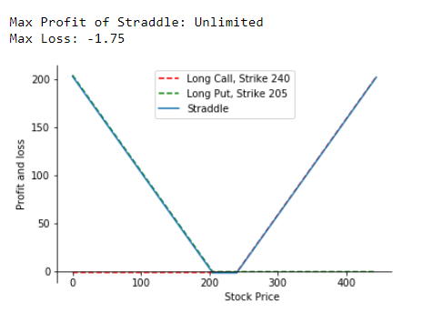
Most Uncertain Stock: NVDA
Notes:
Based on our analysis, we have determined that a straddle would be most applicable hedging strategy as we predict stock price of NVDA to either rise or fall from the strike price by an amount more than the total cost of the premium paid.
The profit potential is virtually unlimited, so long as the price of NVDA moves very sharply during the sample period.
The worst case scenario being all options expiring Out of Money if the actual volatility of NVDA is lower than predicted. Net loss would then be the cost of premium paid for the options on top of the volatility of NVDA itself.

Slide 23
Most Uncertain Stock: NVDA
Results, as of Options Expiry at Nov 5
33.89% increase in stock price
Possibly due to favourable announcements of partnerships with Meta
Date | NVDA Adj Close | % Change
18/10/2021 | $222.22 | -
5/11/2021 | $297.52 | 33.89%
Protective Puts | Profit
Without | $13,103,931.9
With | $22,809,194.61 (74.1% increase)
Notes:
During the sample period from 18 Oct to 5 Nov, NVDA stock price rallied 33%, showing that the upward trend has not lost momentum yet.
The actual performance of NVDA during this sample period was consistent with our predictions and this options strategy allowed us to capitalize on the volatility to earn more profits, with our straddle giving us more than 74% in profits compared to just holding NVDA.

Slide 24
THANK YOU !
Notes:
We have now come to the end of our presentation. We would like to express our greatest gratitude to Prof. Huang and Joel for their constant guidance and for the opportunity to do this project.

